Slide 1
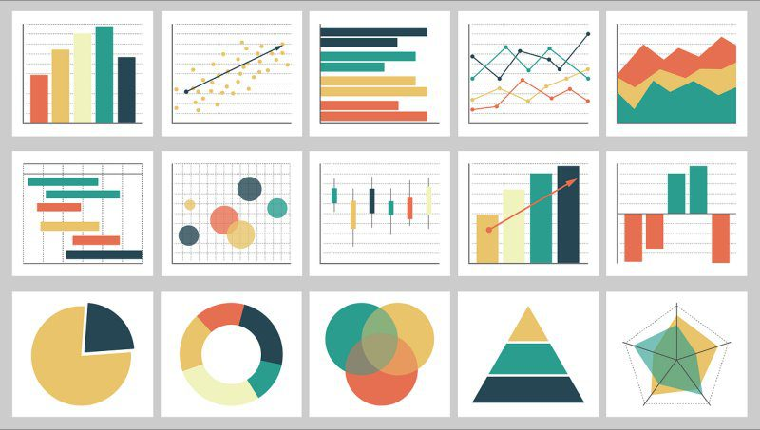
Week 3: Descriptive statistics/Exploratory Data Analysis
Geog4300: Shannon

Slide 2
Know your variable types
Nominal/categorical: non-ordered and qualitative
Geographic regions, land use classifications
Ordinal: qualitative but ranked
Months of the year, storm intensity
Interval: Quantitative but without a true zero
Temperature, years
Ratio: Quantitative and divisible
Rainfall amounts, program budget amounts

Slide 3
What kind of data is it?
Letter grades on an essay exam
Birth year of graduate students in a department
Number of students from each country in a large course
Degree objectives for geography students (BA/BS, MA/MS, Phd)
Flavors of ice cream
Grams of fat in ice cream
% of consumers who prefer particular flavors of ice cream
Nominal/categorical: non-ordered and qualitative
Ordinal: qualitative but ranked
Interval: Quantitative but without a true zero
Ratio: Quantitative and divisible

Slide 4
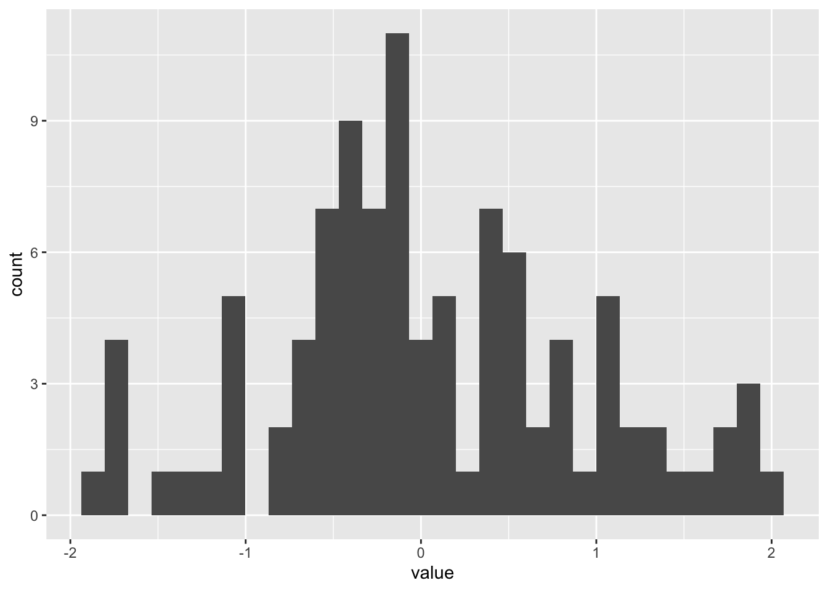
Descriptive statistics
Measures of central tendency:
Mean
Median
Mode
Measures of distribution:
Standard deviation
Interquartile range (IQR)
Coefficient of variation

Slide 5
Which measure of central tendency should we use for the number of UGA football games we have attended? (And how should we wrangle this data before doing so?)
32 | 0
0 | 0 (for now!)
18 | 0
1 | 0
0 | 0
4 | 0
0 | 1
1 | 15
0 | 1
8 | 1
0
9 Football Games

Slide 6

What’s a related question we could ask for which mode would be the appropriate measure of central tendancy?

Slide 7
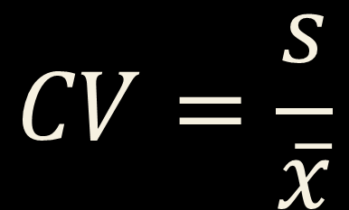
Coefficient of variation
Standard deviation divided by the mean
Useful when means vary across groups or measures
$$CV=\frac{s}{\overline{x}}$$

Slide 8


R challenge!
Load the Daymet data in the class repo: daymet_monthly_median_2010-2021
Calculate the mean, median, standard deviation (sd), and cv for prcp by county. You’ll need to use group_by, summarise, and mutate. Which counties have the highest cv? How does that compare to standard deviation?
$$CV=\frac{s}{\overline{x}}$$

Slide 9
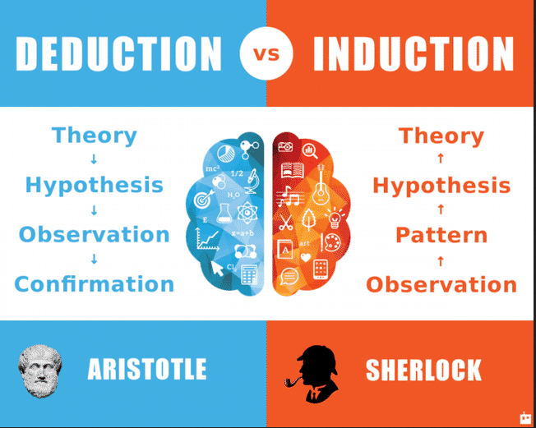
What is exploratory data analysis?

Slide 10
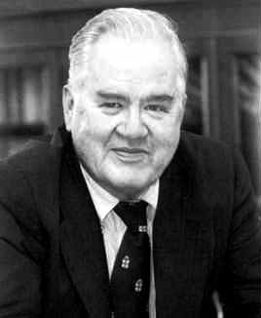
What is exploratory data analysis?
John Tukey
“Numerical quantities focus on expected values, graphical summaries on unexpected values.”

Slide 11
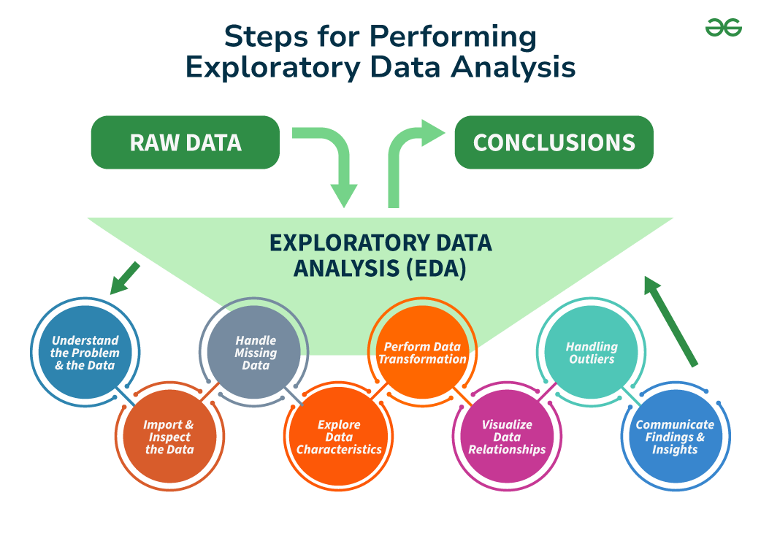
https://www.geeksforgeeks.org/what-is-exploratory-data-analysis/

Slide 12


Tukey and Wickham on Exploratory Data Analysis
Notes:
Depending your approach, classification methods can paint very different pictures of the same data points.
How might we interpret the natural breaks map differently from the quantiles map here?

